Slide 1

Futurense
Democratizing Tech Talent to deliver impact at scale

Slide 2
NYC Taxi Data

Slide 3
Overview:
Brief Description: Our project involves handling and analyzing vast New York City taxi service data, including yellow taxis, green taxis, and app-based for-hire vehicles like Uber and Lyft. The company is seeing exponential increase in data volumes, so they are looking for faster turnaround time in terms of data processing and new requirement implementation.
Business Problem: 1] Diverse Data Sources and Formats
2] Exponential Data Volume Growth
3] Data Availability and Raw Data Preservation
4] Approach Comparison

Slide 4
General Architecture of Data Engineering Projects:

Slide 5
Solution Approach: Implement data transformation processes to ensure clean data is readily available in the Data Warehouse by refining raw data stored in the Data Lake.
Target Storage
Azure Synapse Analytic
ADLS
JSON
Parquet
Blob
CSV
Compute
Storage
File Type
CSV
Azure Synapse Analytic
Data Warehouse
Spark Pool
Dedicated SQL Pool

Slide 6
Tools and Technologies Used:
Data Warehousing and Analytics
Azure Synapse Analytics
Dedicated SQL Pool
Spark Pool
Data Storage
Blob Storage
ADLS GEN2
Data Integration and ETL
Azure Data Factory
Cloud Platform
Microsoft Azure

Slide 7
Libraries/Packages/Features Used:
Libraries and Packages:
pyspark.sql.function
Pyspark.sql.types
Functions and Features:
Derived Columns
Read/Write modes
Handling Missing value
Handling Duplicates value
Group By with aggregate
Joins
Filtering value at row level
Dropping columns

Slide 8
Headline Statistics (1/2):
Number of comments written: On each execution
Data Volume (TB/GB/PB): 2 GB
Number of Data Sources: 2
Avg. No of Data transformation: 3
Avg. No of functions used: 5
Avg. No of lines per Data set: 11

Slide 9
Headline Statistics (2/2):
Spark Configurations:
No of cluster used in project: 1
No of Nodes used in project: 3-4
No of Cores: 4
Size of each Node : 32 GB

Slide 10
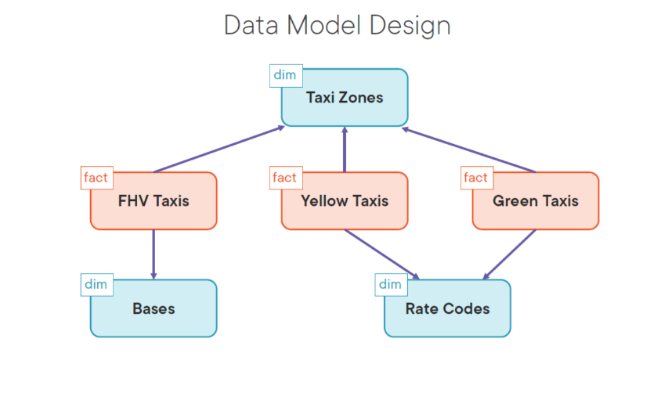
Relevant Diagram/s:
Sources
Fact Tables
Dimension Tables
Staging
Tables

Slide 11
Data Model Overview:
Facts:
FHV Taxis Fact: This fact table contains information related to FHV (For-Hire Vehicles) taxis, and it's linked to the "Bases" dimension. The "Bases" dimension helps determine the dispatch-based location of each FHV taxi.
Yellow Taxis Fact: This fact table contains information about yellow taxis and is linked to the "Rate Codes" dimension. The "Rate Codes" dimension provides details about whether a trip is shared, solo, or specific to an airport.
Green Taxis Fact: Similar to the yellow taxis fact, this table captures data for green taxis and is linked to the "Rate Codes" dimension.

Slide 12
Data Model Overview:
Dimensions:
Bases Dimension: This dimension holds data related to the dispatch-based location of the taxis, which can be valuable for understanding taxi operations.
Rate Codes Dimension: This dimension provides information about the type of taxi trip, such as shared, solo, or airport-related. It helps categorize and analyze trip details.
Taxi Zones Dimension: This dimension is linked to all three fact tables and provides crucial pickup and drop location details for each trip. It helps in understanding the geographical aspects of taxi services.

Slide 13
Why Stage Tables ?
Data Quality Assurance:
Staging tables act as an initial checkpoint for data quality.
Error Handling:
Provide a dedicated space to capture data errors and anomalies.
Data Versioning:
This is useful for tracking changes over time.
Historical Data Preservation:
This is valuable for auditing, historical reporting, and compliance requirements.
Recovery and Rollback:
In case of ETL failures or unexpected issues during data processing, staging tables offer a level of data recovery and rollback.

Slide 14
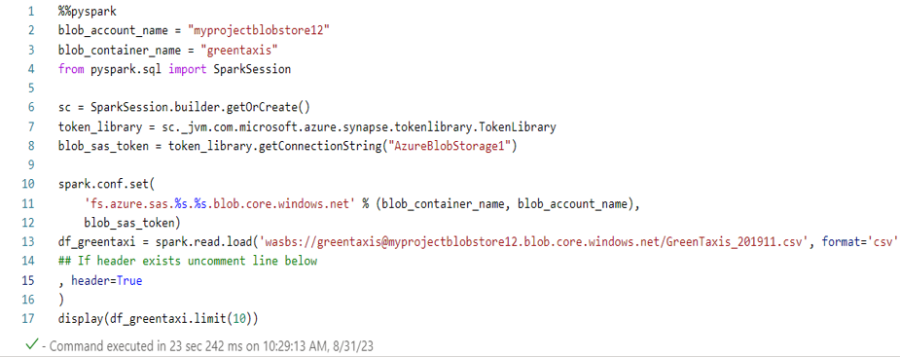
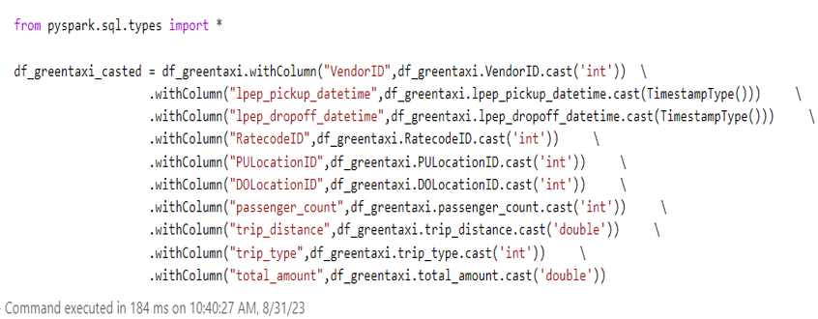
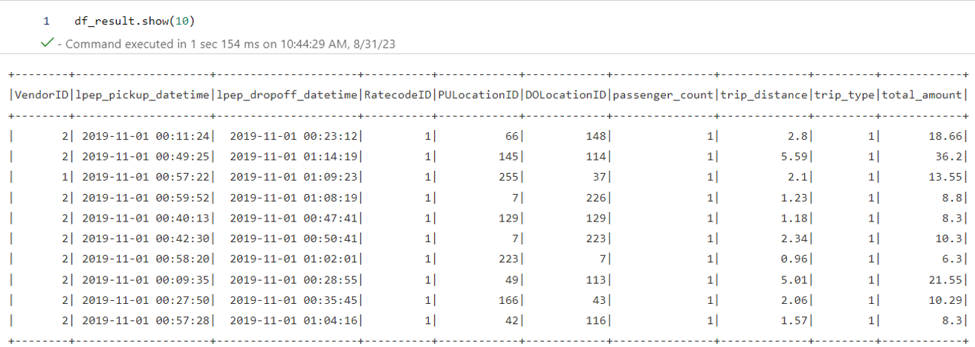
Implementation Screenshots/Code Snippets:
Data Transformation
Data Loading
Final Data

Slide 15
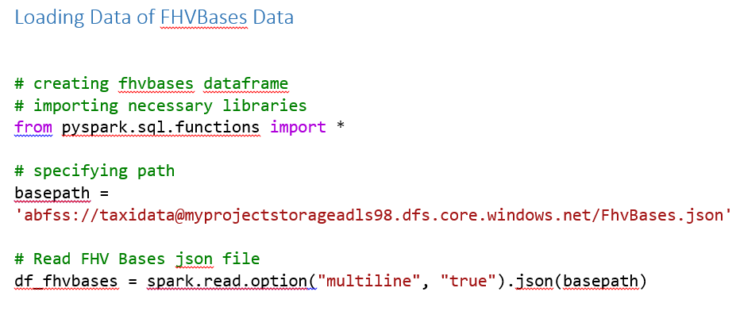
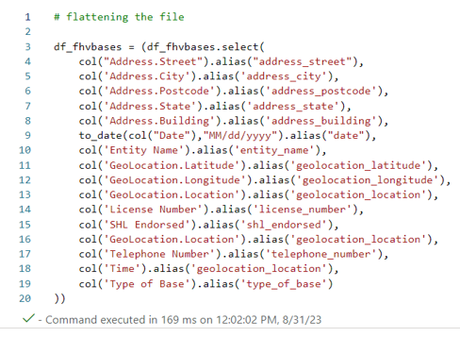
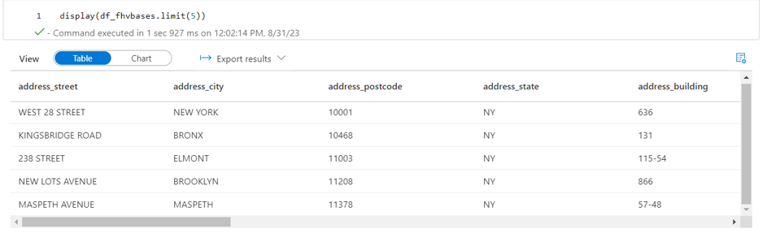
Implementation Screenshots/Code Snippets:
Data Transformation
Final Data
Data Flattening

Slide 16
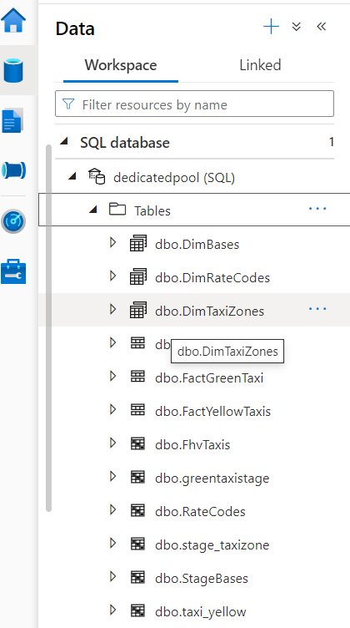
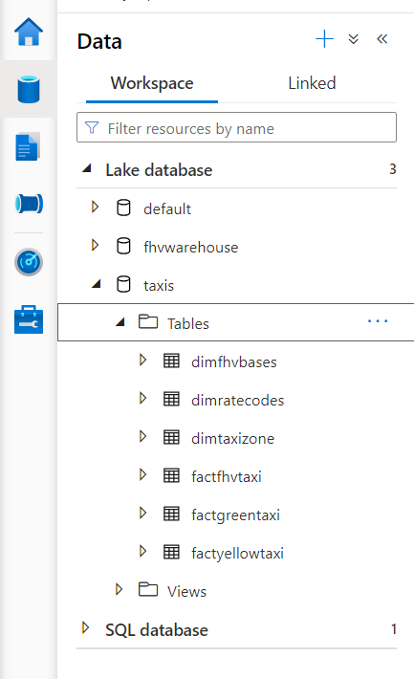
Relevant Diagram/s:

Slide 17
Approach Comparison:
Use Dedicated SQL Pool if:
You primarily work with structured data and need complex SQL-based analytics.
Your primary goal is traditional data warehousing, business intelligence, and historical data analysis.
You have users who are skilled in SQL.
Use Spark Pool if:
Your workload involves a mix of structured and unstructured data, and you need versatile data processing capabilities.
You're focused on data preparation, ETL, machine learning, or real-time streaming.
You have a team proficient in programming languages like Scala or Python.
We can use both Dedicated SQL Pool and Spark Pool in tandem within the same Synapse workspace to cover a wide spectrum of data processing and analytics requirements. The choice between them should align with your specific data and analytical needs.

Slide 18
Roadblocks & Resolutions:
Sourcing Data from Azure Blob Storage:
Created a azure Data Factory pipeline to move the data to ADLS with transformations.
Managing complex nested JSON structures:
Utilize the ‘multiline = True’ and ‘col’ with ‘alias’ to efficiently flatten JSON arrays and maps for streamlined analysis.

Slide 19
Future Scope:
Additional Data Sources
Real-time Data Processing
Data Monetization
Enhanced Data Quality and Data Governance

Slide 20
Thank You

